Slide 1
Lecture 6:
2.2. Ancient Empires: “Efflorescences” and Falls
Brad DeLong
Department of Economics and Blum Center, U.C. Berkeley; WCEG; and NBER
last revised: 2020-02-06
for presentation: 2020-02-11
Original course by Melissa Dell (Harvard Econ 1342), revised by Brad DeLong, research assistance by Anish Biligiri
<https://github.com/braddelong/public-files/blob/master/econ-135-lecture-6.pptx>

Slide 2
Roadmap for the Next Week
6. Civilizational "Efflorescences" and Imperial Declines (Feb 11):
Read Before: Willem M. Jongman (2007): Gibbon was Right: The Decline and Fall of the Roman Economy <https://delong.typepad.com/jongman-gibbon-was-right.pdf>
Read Before: Peter Temin: The Roman Market Economy, Roman Growth <https://delong.typepad.com/files/temin-roman-growth.pdf>
Slides: <https://github.com/braddelong/public-files/blob/master/econ-135-lecture-6.pptx>
Finish: Assignment 4: Malthusian economies paper; due Feb 12
7. Why Was Pre-Industrial Progress so Slow on Average? (Feb 13):
Read Before: Josh Ober (2019): Agamemnon's Cluelessness, selections <https://delong.typepad.com/files/ober-agamemnon-selections.pdf>
Read Before: Moses Finley: Technical Innovation and Economic Progress in the Ancient World <https://delong.typepad.com/finley-technical.pdf>
Slides: <https://github.com/braddelong/public-files/blob/master/econ-135-lecture-7.pptx>
Start: Assignment 5: Simulations with the Solow growth model; due Feb 19 <https://bcourses.berkeley.edu/courses/1487685/assignments/8065916>
8. Commercial Revolutions (Feb 18):
Read: Christopher Berry (2018): Adam Smith: A Very Short Introduction <https://delong.typepad.com/files/berry-smith.pdf>
Slides: <https://github.com/braddelong/public-files/blob/master/econ-135-lecture-8.pptx>
Finish: Assignment 5: Simulations with the Solow growth model; due Feb 19 <https://bcourses.berkeley.edu/courses/1487685/assignments/8065916>

Slide 3
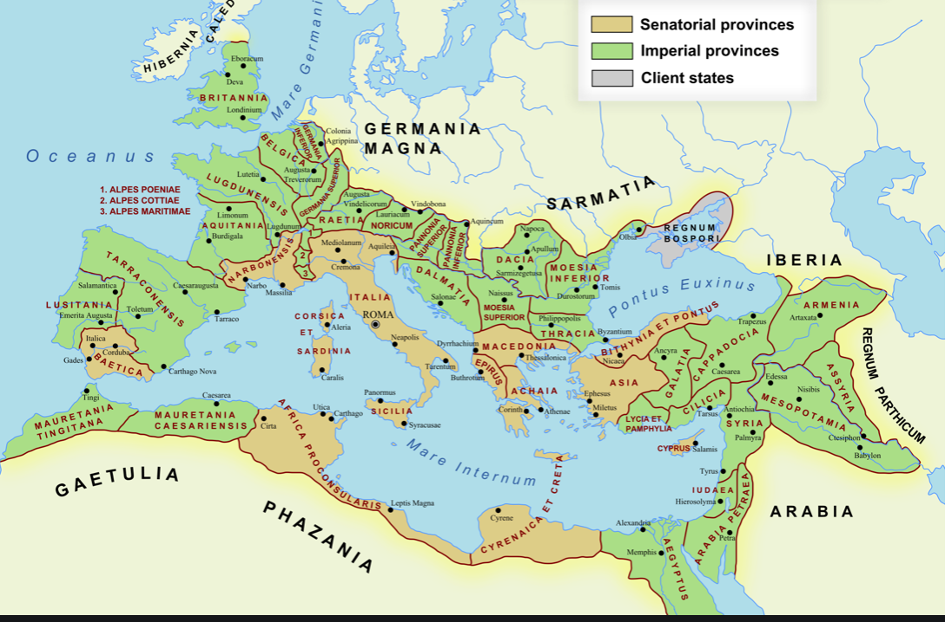
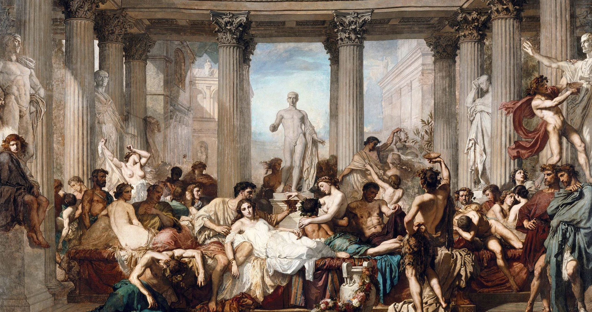
Preview: Lecture 6: Ancient Empires
What I am going to cover:
“Efflorescences”: prosperity in classical Greece and Rome
The rise of the Roman Empire
Review something…
The fall of the Roman Empire
What’s going to be on the exam?
What are the key takeaways?

Slide 4
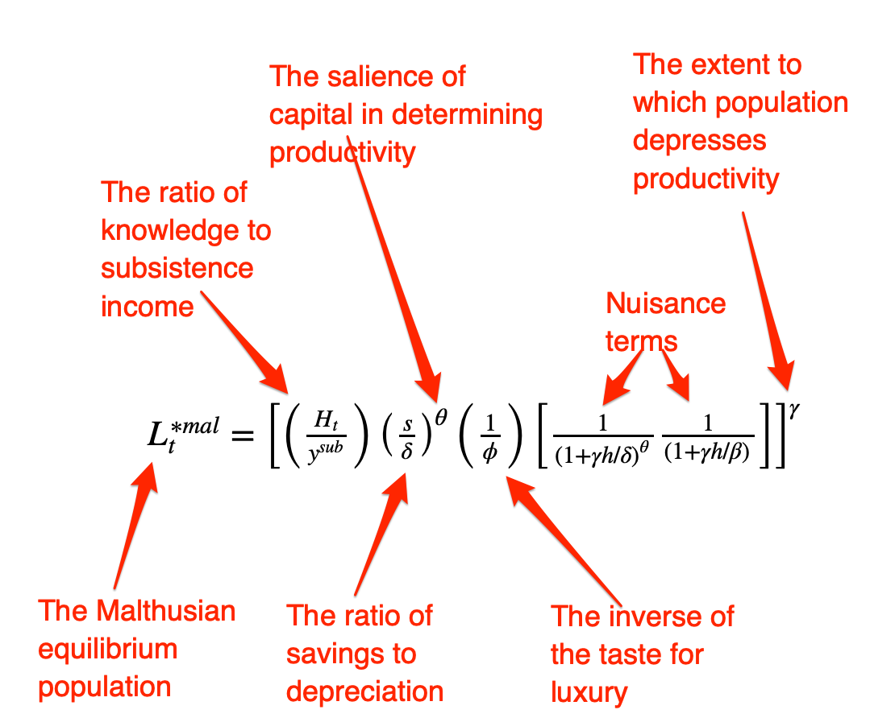
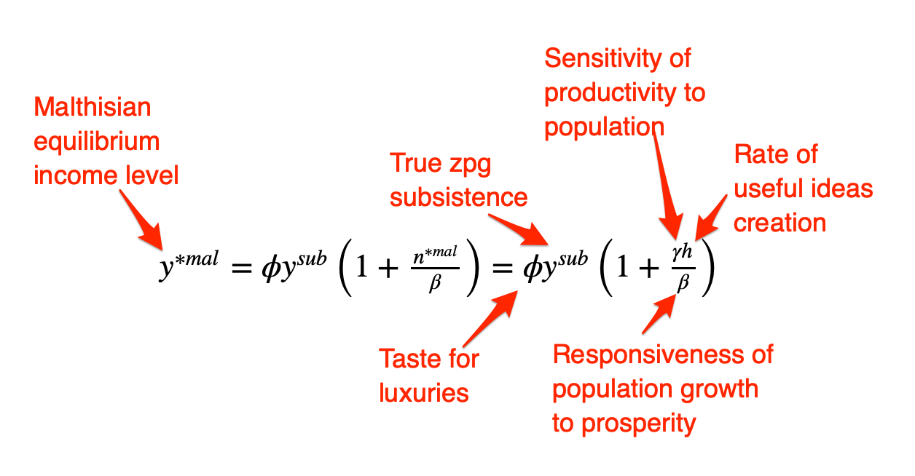
Pre-Industrial “Efflorescences” (and Declines)
Ideas courtesy of Jack Goldsmith, Daron Acemoglu and James Robinson:
The Malthusian model misses a great deal of the interesting action prior to the industrial revolution.
An alternative explanation for why there was no long-run trend in living standards is the theory of ‘efflorescence and decline’
I organize my thoughts about this with the two Malthusian equations, and with their bunch of variables and parameters: h, γ, β, φ, y^{sub}, s, δ, θ, and H that together determine y^{*mal} and L^{*mal}
This is best thought of as a filing system for factors that may be important—given the importance of both capital and labor efficiency, the roles of ideas and of resources in producing labor efficiency, and Malthusian population dynamics, these are the things you should look at

Slide 5
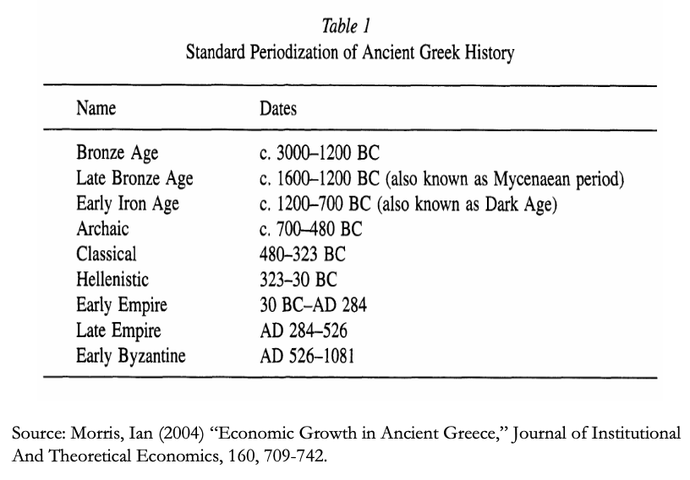
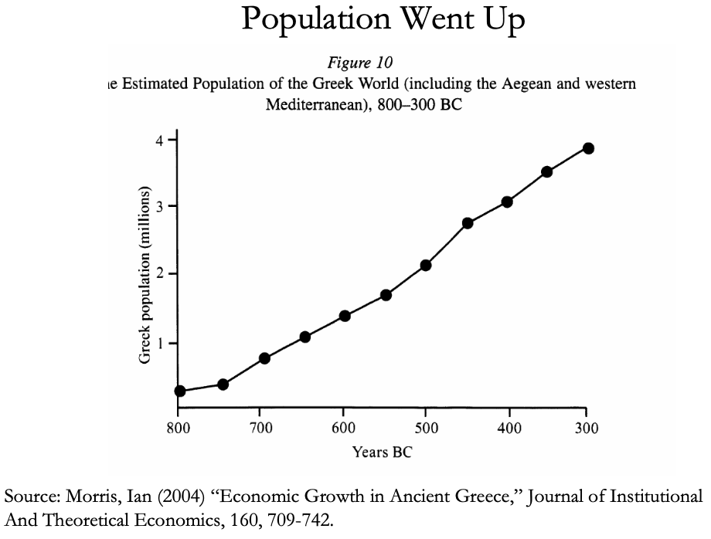
The Classical Greek Efflorescence
Emerging out of the Iron Dark Age of -1200 to -800:
When the Greek city states emerged they did so with functional systems of governance which provided public goods, such as security for trade and investment.
This initiated a period of sustained increases in living standards.
While Ancient Greece did have a period of democracy, it was relative short (less than 200 years) compared to the duration of the polity and most citizens - slaves, poor citizens who couldn’t afford their tax bill, women - could not participate.
Greek institutions (rules according to which the society was organized) tended to be “extractive.” For example, the economy was largely based upon slavery.
Slide taken from Melissa Dell

Slide 6
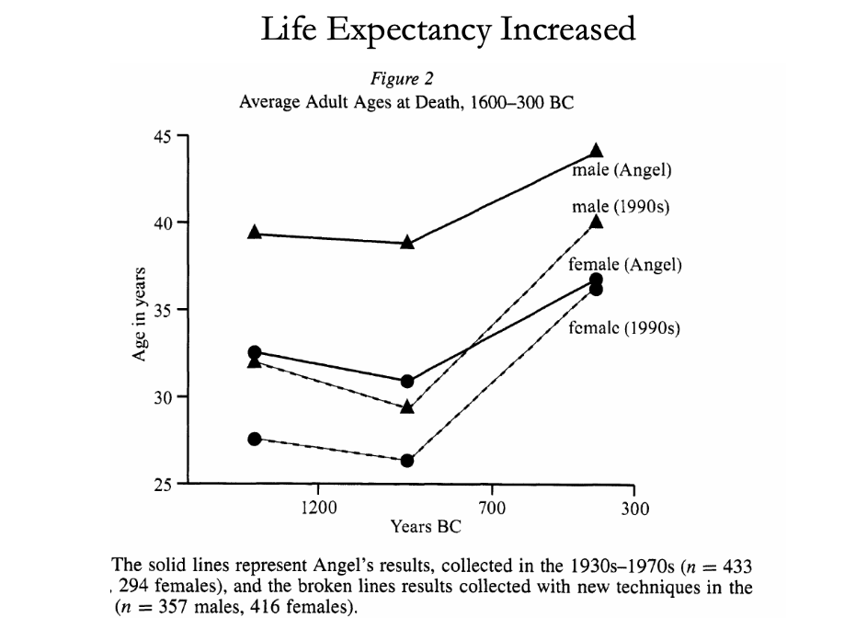
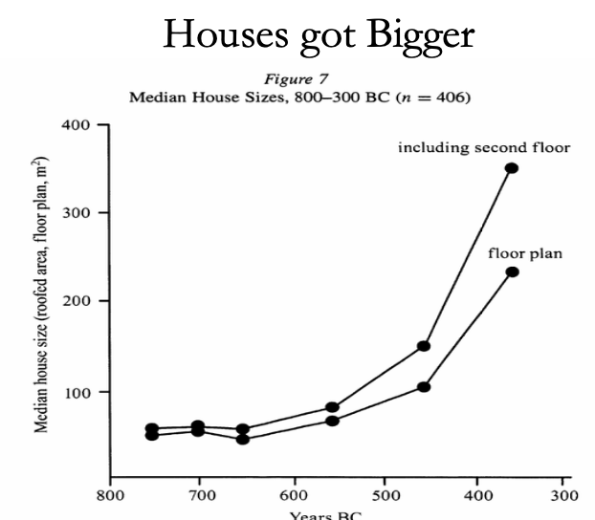
The Classical Greek Efflorescence II
“Developmental” or “Extractive”?
Extractive political institutions concentrate political power in the hands of some group who can use that power to redistribute wealth and income to themselves. This resulting concentration of wealth tends to reinforce the initial set of political institutions.
Roving bandits or stationary bandits?
Acemoglu and Robinson hypothesize that growth was not sustained in ancient societies because their institutions were extractive, and extractive institutions are incompatible with sustaining growth in the long run.
They argue that this is because extracting resources creates conflicts over who will control those resources, and it may also induce rebellion from below.
In either case political instability can bring the government and economy down.
Slide taken from Melissa Dell

Slide 7
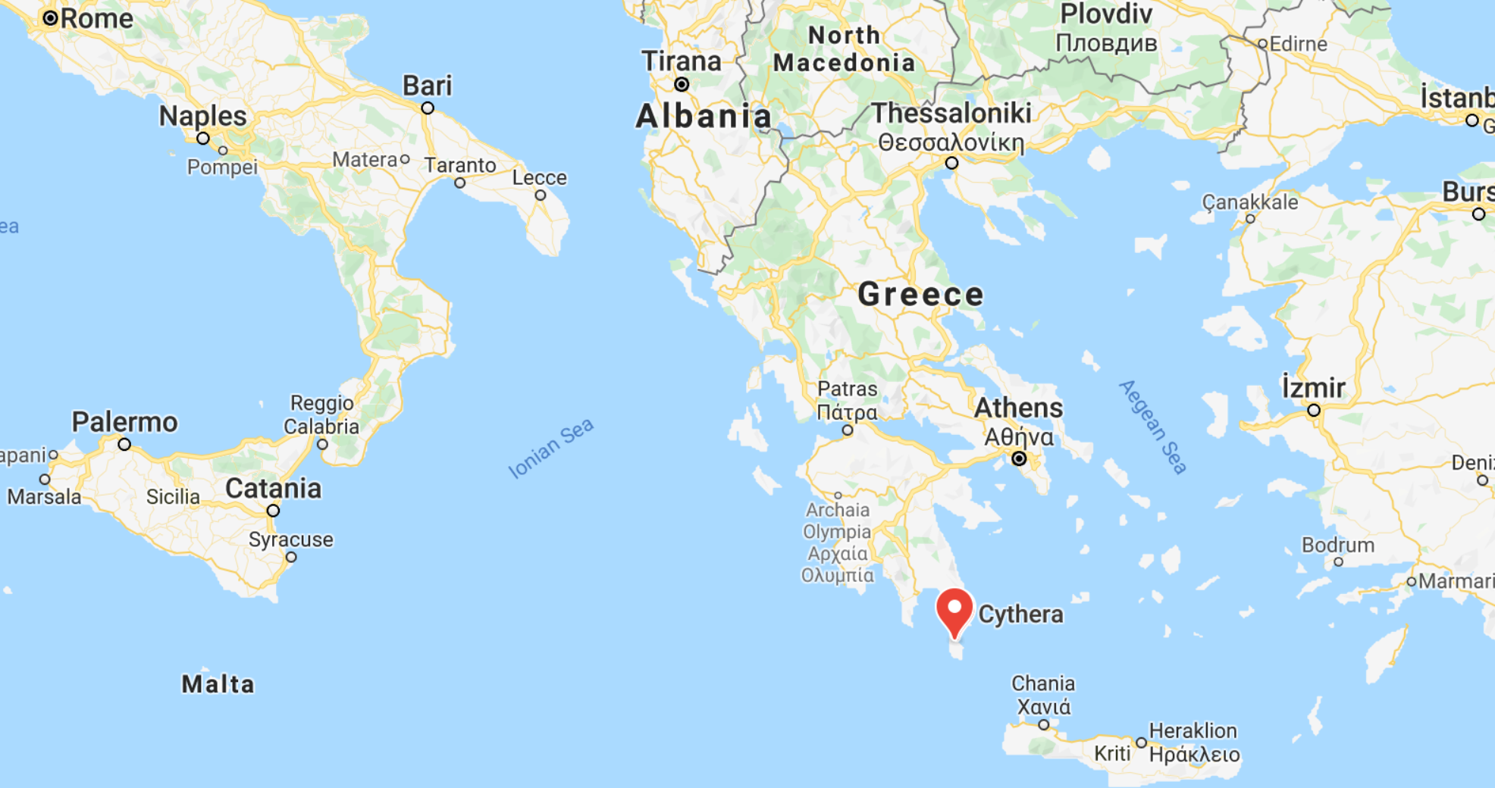
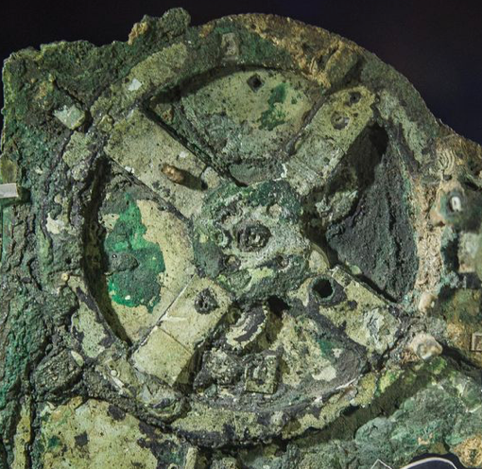
The Anti-Kythera Mechanism
What is this?
Built between -150 and -70. Rhodes?
Being carried Romewards in a wooden box in a 13” x 7” x 4 “ wooden box
Gears—largest 5” in diameter
Inscriptions
Wikipedia: “37 gear wheels enabling it to follow the movements of the Moon and the Sun through the zodiac, to predict eclipses and even to model the irregular orbit of the Moon, where the Moon's velocity is higher in its perigee than in its apogee. This motion was studied in the 2nd century BC by astronomer Hipparchus of Rhodes, and it is speculated that he may have been consulted in the machine's construction. The knowledge of this technology was lost at some point in antiquity. Similar technological works later appeared in the medieval Byzantine and Islamic worlds, but works with similar complexity did not appear again until the development of mechanical astronomical clocks in Europe in the fourteenth century…”
Brian Resnick: “A main gear would move to represent the calendar year, and would, in turn, move many separate smaller gears to represent the motions of the planets, sun, and moon. So you could set the main gear to the calendar date and get approximations for where those celestial objects would be in the sky on that date…. You, as a user, could input a few simple variables and it would yield a flurry of complicated mathematical calculations.… All the user had to do was enter the main date on one gear, and through a series of subsequent gear turns, the mechanism could calculate things like the angle of the sun crossing the sky. (For some reference, mechanical calculators—which used gear ratios to add and subtract—didn’t arrive in Europe until the 1600s)…”

Slide 8
Cicero (-54): De Re Publica
“With the exception of the dream of Scipio, in the last book, the whole treatise was lost till the year 1822, when the librarian of the Vatican discovered a portion of them among the palimpsests in that library. What he discovered is translated here; but it is in a most imperfect and mutilated state. The form selected was that of a dialogue, in imitation of those of Plato…”
I.XIV:
Then Philus said: “I am not about to bring you anything new, or anything which has been thought over or discovered by me myself. But I recollect that Caius Sulpicius Gallus, who was a man of profound learning, as you are aware, when this same thing was reported to have taken place in his time, while he was staying in the house of Marcus Marcellus, who had been his colleague in the consulship, asked to see a celestial globe which Marcellus’s grandfather had saved after the capture of Syracuse from that magnificent and opulent city, without bringing to his own home any other memorial out of so great a booty; which I had often heard mentioned on account of the great fame of Archimedes; but its appearance, however, did not seem to me particularly striking. For that other is more elegant in form, and more generally known, which was made by the same Archimedes, and deposited by the same Marcellus in the Temple of Virtue at Rome.
“But as soon as Gallus had begun to explain, in a most scientific manner, the principle of this machine, I felt that the Sicilian geometrician must have possessed a genius superior to anything we usually conceive to belong to our nature. For Gallus assured us that that other solid and compact globe was a very ancient invention, and that the first model had been originally made by Thales of Miletus. That afterward Eudoxus of Cnidus, a disciple of Plato, had traced on its surface the stars that appear in the sky, and that many years subsequently, borrowing from Eudoxus this beautiful design and representation, Aratus had illustrated it in his verses, not by any science of astronomy, but by the ornament of poetic description. He added that the figure of the globe, which displayed the motions of the sun and moon, and the five planets, or wandering stars, could not be represented by the primitive solid globe; and that in this the invention of Archimedes was admirable, because he had calculated how a single revolution should maintain unequal and diversified progressions in dissimilar motions.
“In fact, when Gallus moved this globe, we observed that the moon succeeded the sun by as many turns of the wheel in the machine as days in the heavens. From whence it resulted that the progress of the sun was marked as in the heavens, and that the moon touched the point where she is obscured by the earth’s shadow at the instant the sun appears opposite….
Scipio: “I had myself a great affection for this Gallus, and I know that he was very much beloved and esteemed by my father Paulus. I recollect that when I was very young, when my father, as consul, commanded in Macedonia, and we were in the camp, our army was seized with a pious terror, because suddenly, in a clear night, the bright and full moon became eclipsed. And Gallus, who was then our lieutenant, the year before that in which he was elected consul, hesitated not, next morning, to state in the camp that it was no prodigy, and that the phenomenon which had then appeared would always appear at certain periods, when the sun was so placed that he could not affect the moon with his light…”

Slide 9
The Rise of Rome
Roman Institutions are key to the rise of Rome:
In 510BC, the citizens of Rome overthrew their king, Lucius Tarquinius Superbus, and created a republic.
The state was run by elected officials:
Two consuls who had the job for one year
Other magistrates: praetors, aediles, proconsuls
Tribunes.
Offices were elected, annual, and held by multiple people at the same time
This greatly reduced the ability of any one person to consolidate or exploit his power.
The institutions of the Republic contained a system of checks and balances which distributed power fairly widely.
Even if elite patrician families had far more power, it was possible for non-elites, so called plebeians, to get to the top, and they constrained the power of the elites.
Then some plebeian families become equally elite…
The nobiles
Roman assemblies:
Centuriate: 193 centuries on the basis of military organization, weighted toward the rich. Elects the magistrates, declares war and peace
Tribal: After 241 BC, 35 tribes on the basis of geographical location
Plebeian: Non-patricians, run by Tribunes
Senate
Roman institutions:
Legions
Phalanx
Manipular
Marian
Imperium
Provinciae
Proconsuls and propraetors
Slide taken from Melissa Dell

Slide 10
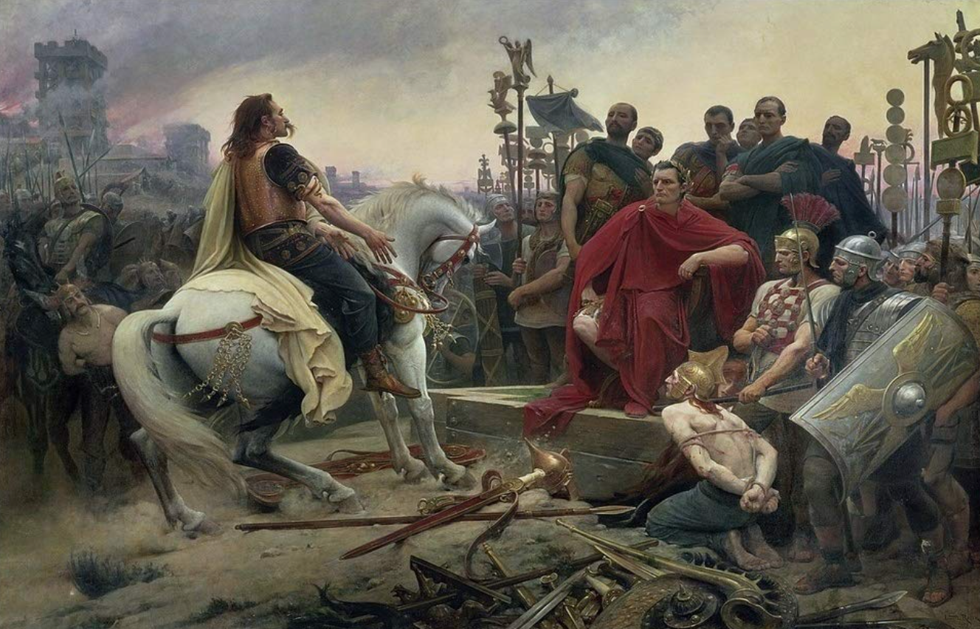
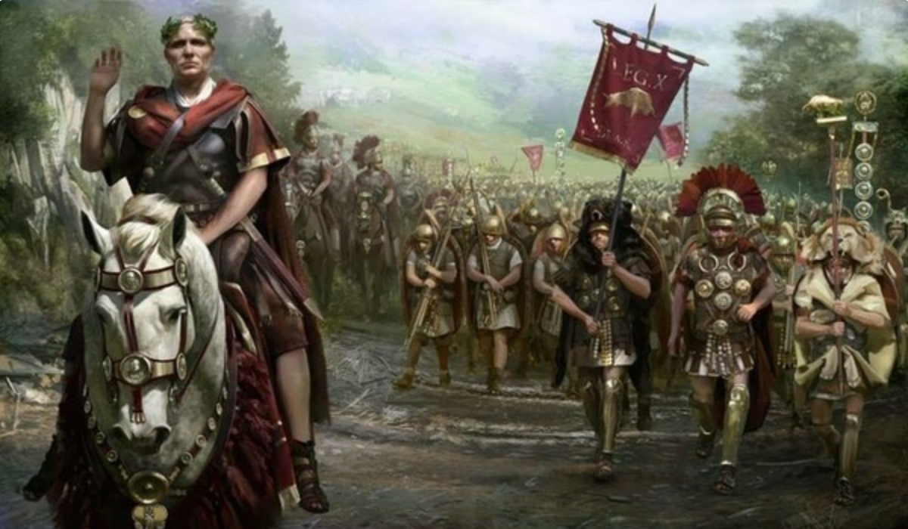
The Rise of Rome II
Roman Institutions are key to the rise of Rome:
Four key factors:
Militarism (on the part of elites competing for authority)
Mobilization (of the citizen mass)
Widely shared benefits (of conquest)
Incorporation (of conquered communities)
Mammoth military and political expansion after -340, and substantial economic, expansion
Slide taken from Melissa Dell

Slide 11
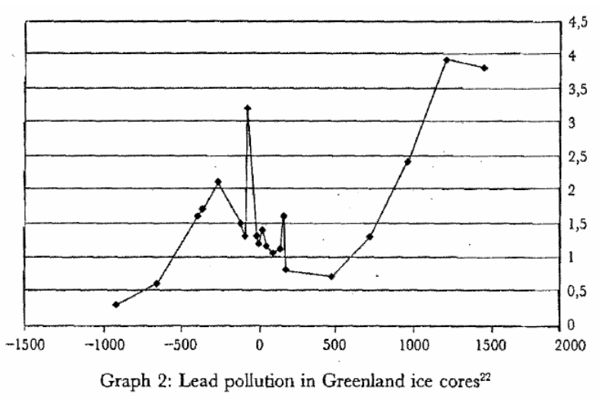
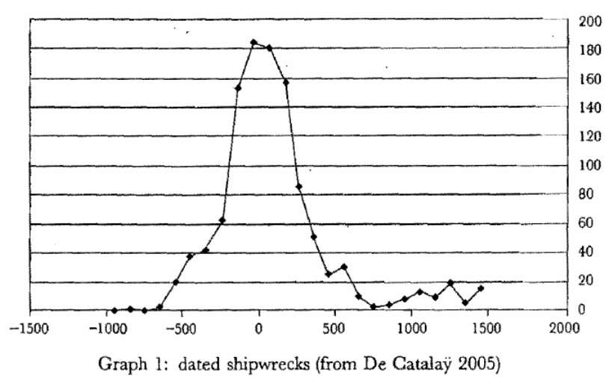
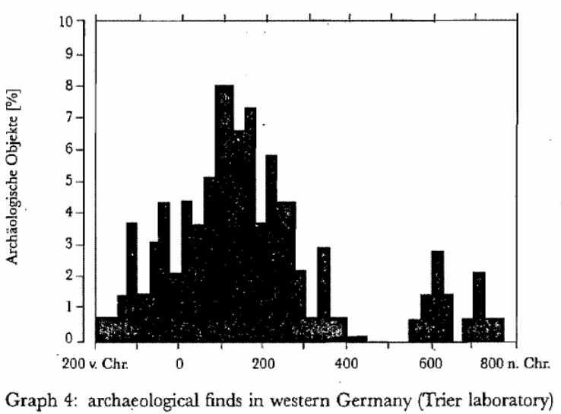
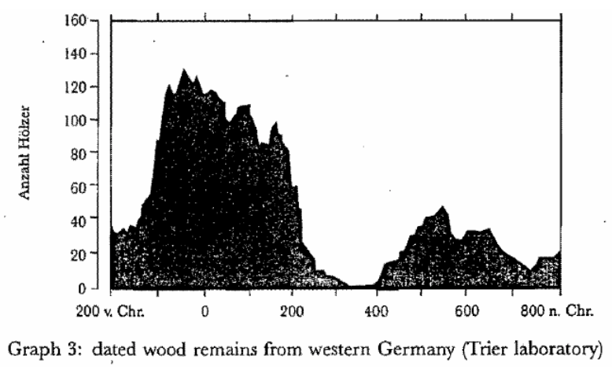
Measuring Roman Efflorescence
There are many interesting ways to track economic expansion:
Shipwrecks indicate trade, but they also track the movement of goods by fiat. For example, the citizens of Rome were kept happy by the free distribution of bread after 58BC. This was later extended to olive oil and even wine. This had to be shipped (mostly from Egypt and North Africa).
The Romans also moved around taxes levied in the provinces and supplied their troops. Some argue that 2/3 of all the ‘trade’ was actually the state moving stuff around.
For Roman citizens, economic institutions were quite good. However, the Italian economy was based on slavery (about 35% of the population of Italy were slaves at the time of the Emperor Augustus). There was little technological change.
Slide taken from Melissa Dell

Slide 12
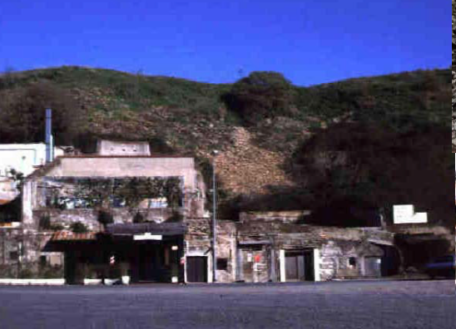
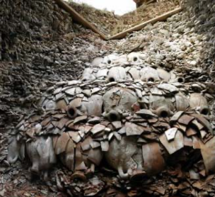
Pottery Mountain in Rome
53 million broken amphorae
Slide taken from Melissa Dell

Slide 13
Republic to Empire
Political transition:
The expansion of Rome’s conquests created inequality and increasing political instability.
There were calls for the redistribution of land and power.
For example, Plebeian Tribune Tiberius Gracchus started to develop very ‘populist’ political platforms which threatened the senatorial elites.
The culmination of this was civil war, the dictatorship of Julius Caesar, and finally the creation of the Empire under Augustus.
First the principate
Then the dominate
Augustus reformed the army, removing it as a bastion of plebeian power.
His successor Tiberius stripped the assemblies of powers and gave them to the senate—and then neutered the senate
A semi-hereditary monarchy replaced the Republic:
“May good success attend the Roman senate and people and myself. I hereby adopt as my son Marcus Ulpius Nerva Traianus…”
This was a move towards more “extractive” political institutions and though it stabilized things for awhile, there was an eventual movement towards even more extractive economic institutions
Slide taken from Melissa Dell

Slide 14
Always Scribble, Scribble, Scribble! Eh! Mr. Gibbon?
Beste, Memorials:
The Duke of Gloucester, brother of King George III, permitted Mr. Gibbon to present to him the first volume of The History of the Decline and Fall of the Roman Empire. When the second volume of that work appeared, it was quite in order that it should be presented to His Royal Highness in like manner. The prince received the author with much good nature and affability, saying to him, as he laid the quarto on the table,
“Another damned thick, square book! Always, scribble, scribble, scribble! Eh! Mr. Gibbon?”

Slide 15
Always Scribble, Scribble, Scribble! Eh! Mr. Gibbon?
Five Good Emperors: Nerva-Trajan-Hadrian-Antonius Pius-Marcus Aurelius:
If a man were called to fix the period in the history of the world, during which the condition of the human race was most happy and prosperous, he would, without hesitation, name that which elapsed from the death of Domitian to the accession of Commodus.
The vast extent of the Roman empire was governed by absolute power, under the guidance of virtue and wisdom.
The armies were restrained by the firm but gentle hand of four successive emperors, whose characters and authority commanded involuntary respect.
The forms of the civil administration were carefully preserved by Nerva, Trajan, Hadrian, and the Antonines, who delighted in the image of liberty, and were pleased with considering themselves as the accountable ministers of the laws.
Such princes deserved the honor of restoring the republic, had the Romans of their days been capable of enjoying a rational freedom.
The labors of these monarchs were overpaid by
the immense reward that inseparably waited on their success;
by the honest pride of virtue, and
by the exquisite delight of beholding the general happiness of which they were the authors.

Slide 16
Aelius Aristides
The Roman Oration:
Whatever the seasons make grow and whatever countries and rivers and lakes and arts of Hellenes and non-Hellenes produce are brought from every land and sea, so that if one would look at all these things, he must needs behold them either by visiting the entire civilized world or by coming to this city. For whatever is grown and made among each people cannot fail to be here at all times and in abundance. And here the the merchant vessels come carrying these many products from all region in every season and even at every equinox, so that the city appears a kind of common emporium of the world.
Cargoes from India and, if you will, even from Arabia the Blest one can see in such numbers as to surmise that in those lands the trees will have been stripped bare and that the inhabitants of these lands, if they need anything, must come here and beg for a share of their own. Again one can see Babylonian garments and ornaments from the barbarian country beyond arriving in greater quantity and with more ease than if shippers from Naxos or from Cythnos, bearing something from those islands, had but to enter the port of Athens. Your farms are Egypt, Sicily and the civilized part of Africa.
Arrivals and departures by sea never cease, so that the wonder is not that the harbor has insufficient space for merchant vessels, but that even the sea has enough, if it really does.
And just as Hesiod said about the ends of the Ocean, that there is a common channel where all waters have one source and destination, so there is a common channel to Rome and all meet here, trade, shipping, agriculture, metallurgy, all the arts and crafts that are or ever have been, all the things that are engendered or or grow from the earth. And whatever one does not see here neither did nor does exist. And so it is not easy to which is greater, the superiority of this city in respect to the cities that now are or the superiority of this city respect to the empires that ever were…

Slide 17
Three Great Plagues
But the demands of the empire for revenue and of the upper class for resources remain the same:
Antonine Plague (smallpox?): Antonine ⇒ Severian dynasty
Plague of St. Cyrian (Ebola-like?): Things fall completely apart, then Diocletian: between Philip the Arab and Diocletian, 18 emperors in 35 years, plus two breakaways; 12 of the 18 were assassinated
Plague of Justinian (Bubonic): Flavius Apion…

Slide 18
Review: What Should We Review Today?
A number of possibilities:
The grand overview of the history of economic growth
Models:
The Solow growth model
Malthusian forces
“Two heads (almost) twice as good as one” & “low-hanging fruit is picked first” & “institutions matter a lot”
Malthusian economics
& “class power”
Measuring prosperity relative to “subsistence”
Ancient empires (& their rise & fall)

Slide 19
The Fall of Rome
Economic Zenith, Then Economic Decline, Then Political Decline:
While the existing data are somewhat contradictory, the consensus amongst archaeologists is the early 2nd century.
A new social distinction between honestiores (high status) and humiliores (low status with different laws) was introduced.
Citizens began to lose their rights and by the end of the 2nd century, they were being tied to the land as serfs
The Barbarians were at the gates, but it seems reasonable to see this as an outcome of the weakening of Roman institutions
Earlier Rome had defeated far more formidable and better organized enemies like the Carthaginians.
Acemoglu and Robinson argue that the big fact about what preceded the decline is that political institutions moved in a much more extractive direction and this was followed by economic institutions.
Jongman (“Gibbon was Right”) proposes that the Antonine plague which hit the Roman Empire around 160AD is the most likely explanation for the collapse of Rome.
But Malthusian crises are supposed to increase living standards, not reduce them.
Slide taken from Melissa Dell

Slide 20
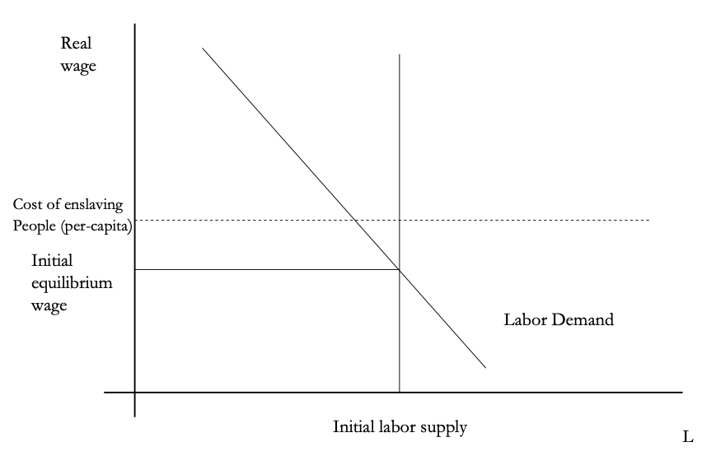
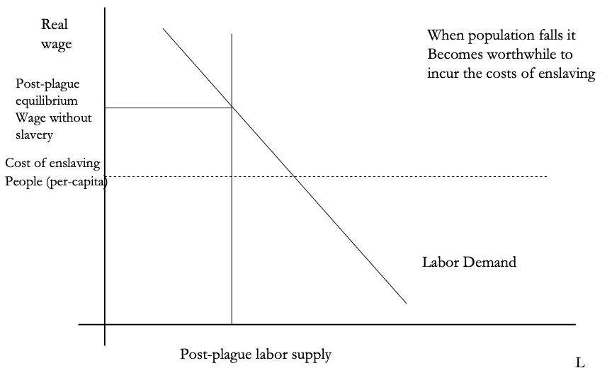
The Domar Hypothesis
You can have a leisured upper class, or abundant land relative to labor, or free labor, but not all three at once:
Slide taken from Melissa Dell

Slide 21
Dell’s Summary of Acemoglu and Robinson on the Rise and Fall of Rome
“Efflorescence” driven by good institutions:
Historically economic growth coincided with institutional innovation: creation of states with working political institutions that could provide public goods, law and order, encourage trade etc.
Functioning states could also raise taxes and fund armies, allowing widespread conquests.
However, they argue these were fundamentally extractive institutions, even if in some cases economic institutions were initially relatively inclusive.
They argue that extractive growth is not sustained because there is little technological change. Moreover, it naturally creates political instability which eventually destroys the institutions which started the growth.
For the Roman Empire, the collapse of Roman authority was pronounced, particularly in the West:
By 450AD all the trappings of Roman economic prosperity were gone.
Money vanished from circulation.
Urban areas were abandoned and buildings stripped of stone.
The roads were overgrown with weeds.
The only type of pottery which was fabricated was crude and hand made, not manufactured.
People forgot how to use mortar and they also forgot how to read and write.
Roofs were made of branches, not tiles.
The Eastern Roman Empire lived on but it contracted significantly with the rise of Islam in the 7th Century.
Slide taken from Melissa Dell

Slide 22
What Will Be on the Exam?
60% short (¶) answers; 40% essay
What will questions be like?

Slide 23
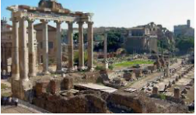
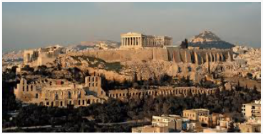
Big Ideas: Lecture 6: Ancient Empires
Takeaways from this lecture:
OK: What should the takeaways from this lecture be?

Slide 24
Catch Our Breath…
Ask a couple of questions?
Make a couple of comments?
Any more readings to recommend?

Slide 25
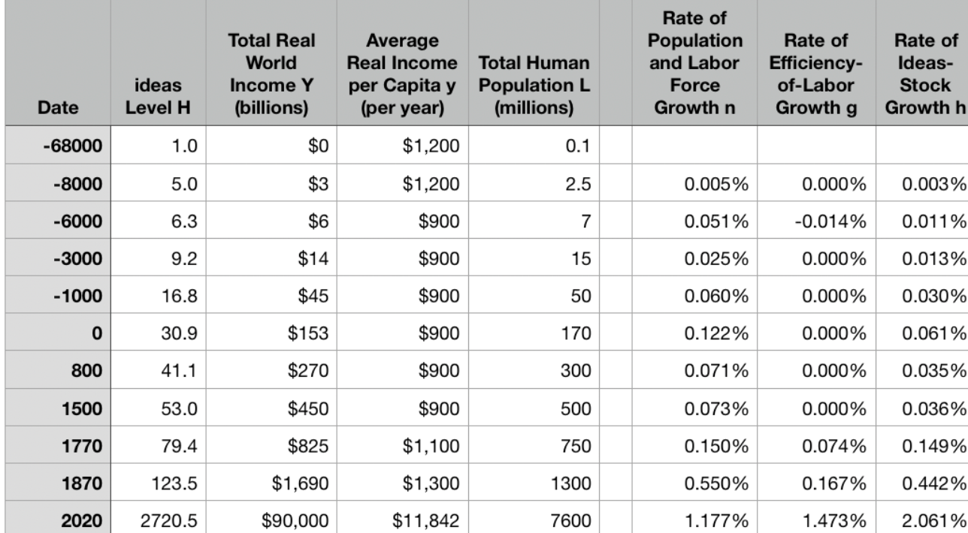
Review: Long-Run Patterns: Global h, g, & n

Slide 26
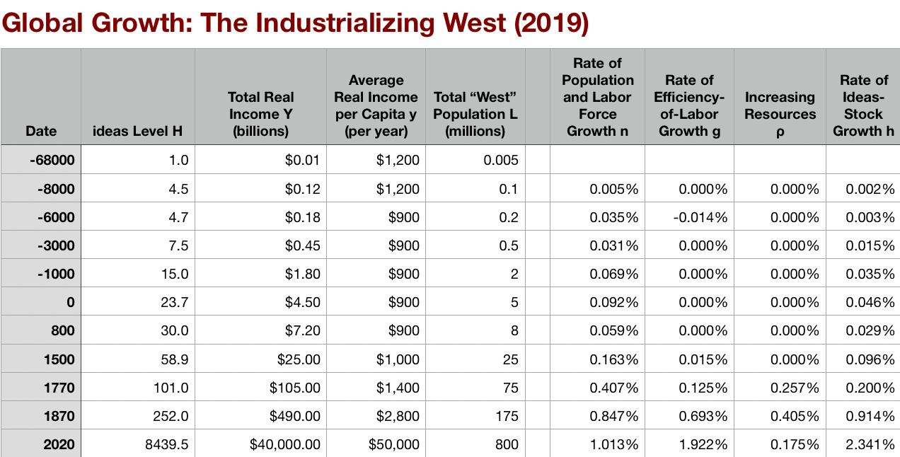
Long-Run Patterns: “Western” h, g & n
Where does the “ρ” come from?
“Ghost acreage”—conquest and resource utilization (sugar islands, timberlands, cottonlands, etc.)
Cultural expansion—Australia, Canada, New Zealand, & U.S.; Spain & Italy & Scandinavia; plus Japan, Korea, Taiwan, Hong Kong, & Singapore

Slide 27
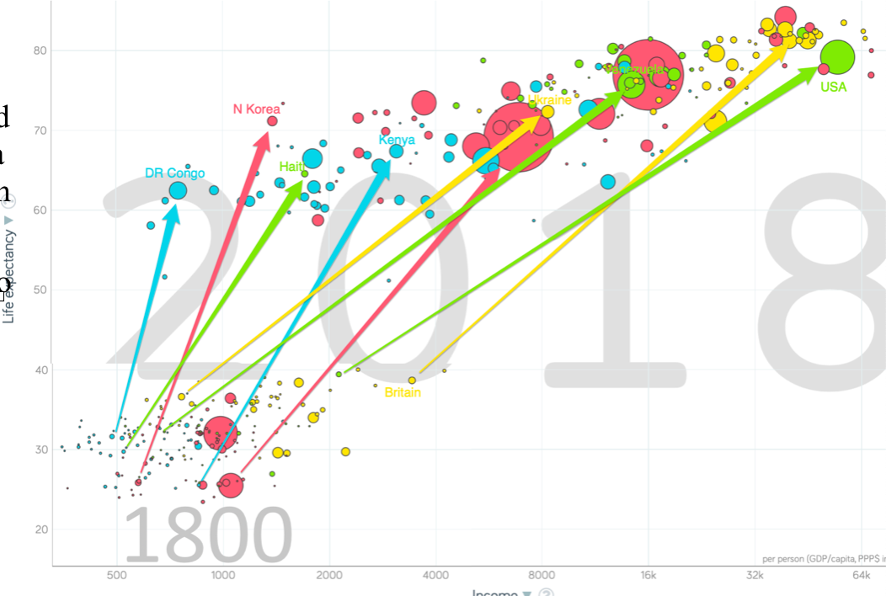
One Figure: A Great Divergence
10:20
From 1800 to 2018:
The dots start with a 3-1 spread in incomes and a 10-year spread in life expectancy.
All the arrows go up.
Some arrows—mostly those already to the right—go right fast.
Other arrows go right slowly.

Slide 28
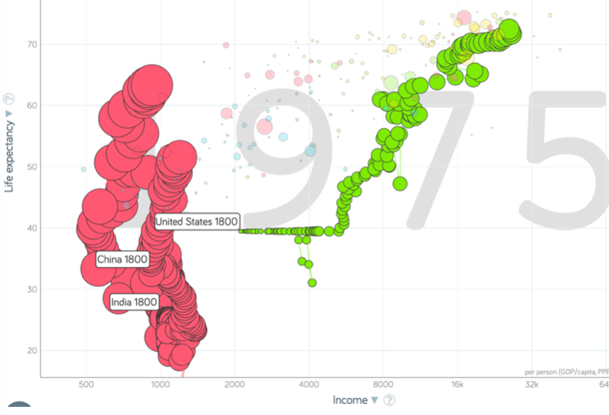
China and India and America, 1800-1975
From 1800 to 1975:
Measured living standards and productivity levels improve fourteen-fold in the United States…
…& less than 30% in China & India…
…in spite of economic, transport, and cultural globalization…
This is crazy!
A “great divergence”
Not only were China & India relatively poor in 1800, they fell further behind thereafter

Slide 29
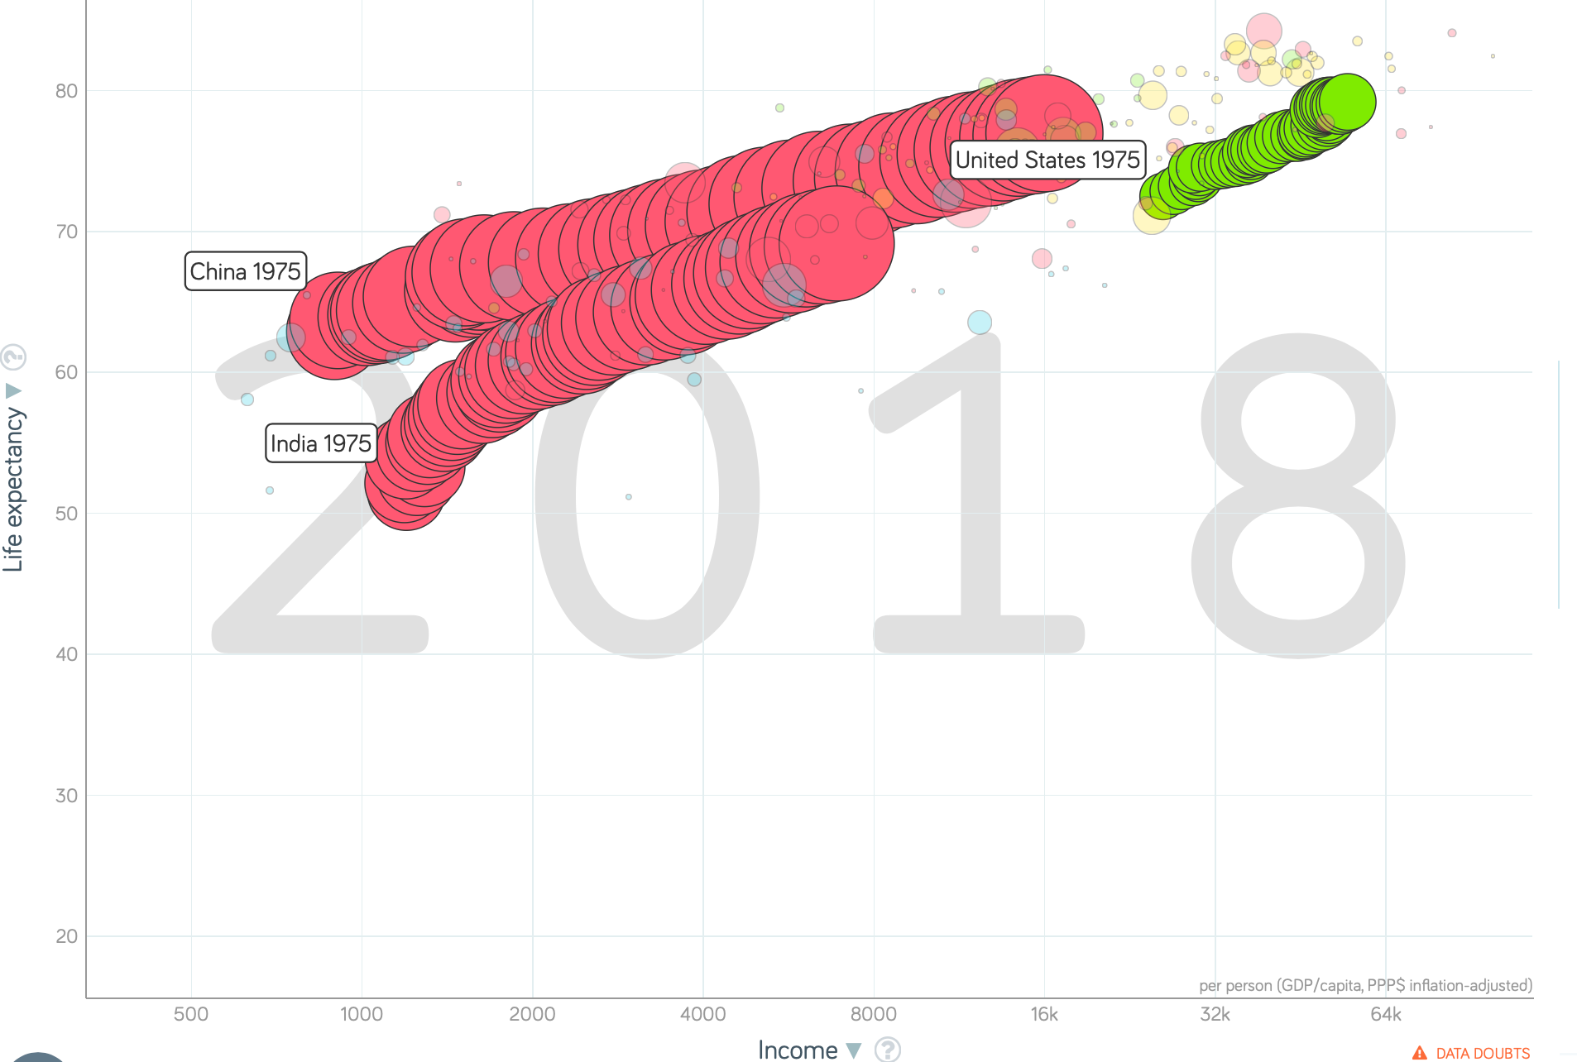
China and India and America, 1975–2018
From 1975-2018:
Measured living standards and productivity levels…
…54.9/25.9 = 2.12 in America…
…16.0/0.9 = 17.8 in China…
…6.9/1.2 = 5.8 in India…

Slide 30
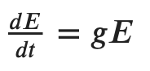
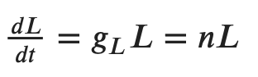
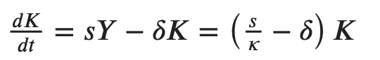
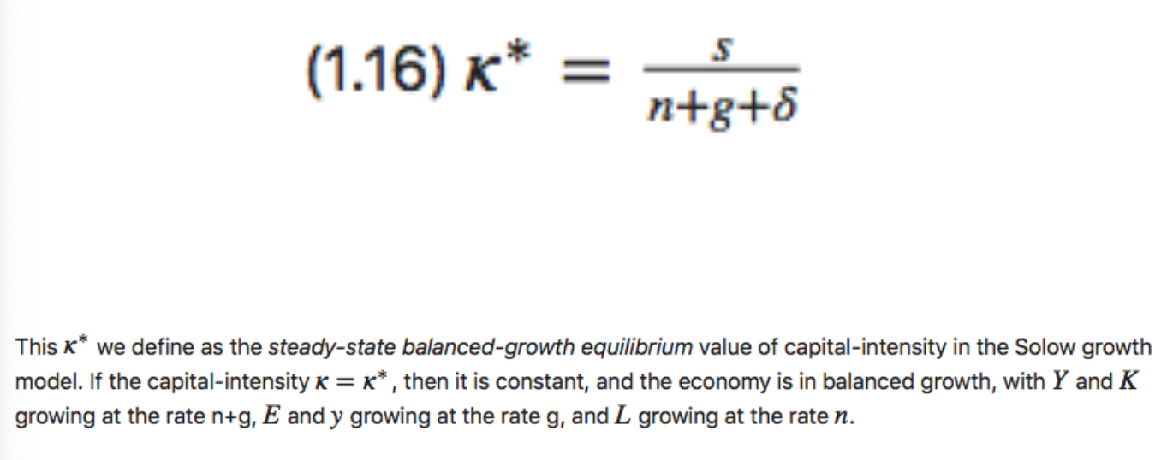
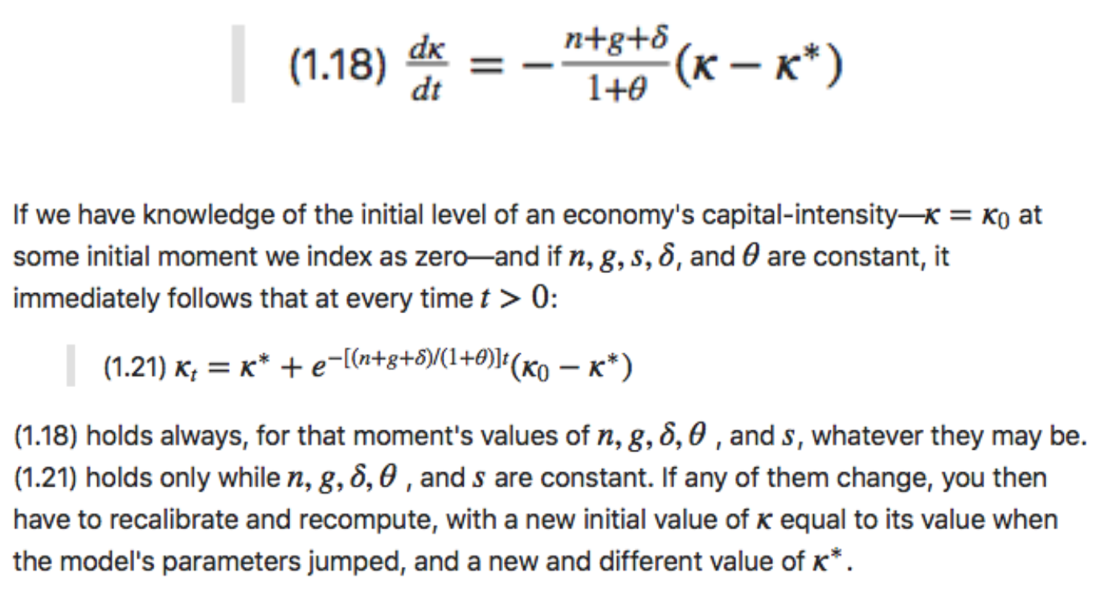
Review: Solow Model Basics
Lecture Notes: <https://www.bradford-delong.com/2020/01/lecture-notes-the-solow-growth-model-the-history-of-economic-growth-econ-135.html>

Slide 31
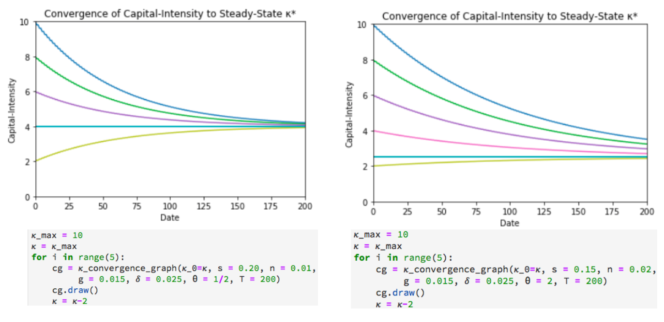
Solving the Model

Slide 32
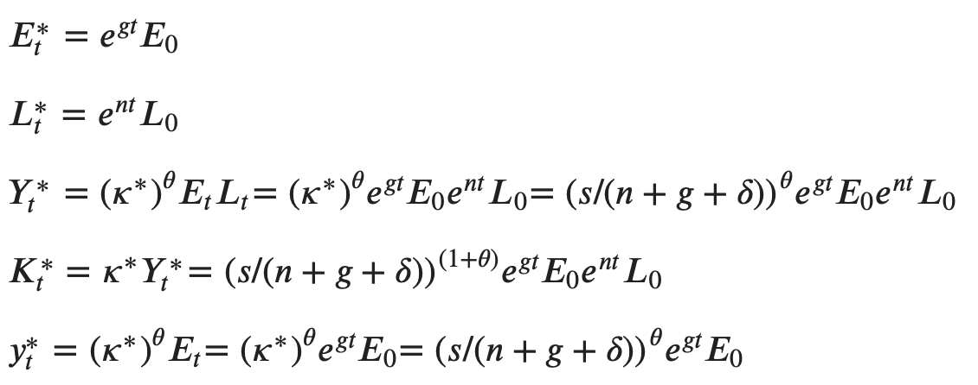
Along the Balanced-Growth Path
Everything except κ—which is constant—grows at a constant proportional rate: either n, or g, or n+g;
Labor force L grows at n
Income per worker y and the efficiency of labor E grow at g
Total income Y and the capital stock K grow at n+g

Slide 33
Review: Solow-Malthus Model Basics
How do we make sense of the fact that people were ingenious and inventive back before 1500, and yet standards of living did not increase?
Although population did increase—slowly
Other parts of the model
Balanced-growth equilibrium
Convergence to equilibrium
Lecture notes: <https://nbviewer.jupyter.org/github/braddelong/long-form-drafts/blob/master/solow-model-5-pre-industrial.ipynb>
datahub: <http://datahub.berkeley.edu/user-redirect/interact?account=braddelong&repo=long-form-drafts&branch=master&path=solow-model-5-pre-industrial.ipynb>

Slide 34
Understanding the Solow-Malthus Equilibrium: Population and Labor Force
Notes:

Slide 35
Understanding the Solow-Mathus Equilibrium: Prosperity
Notes:

Slide 36
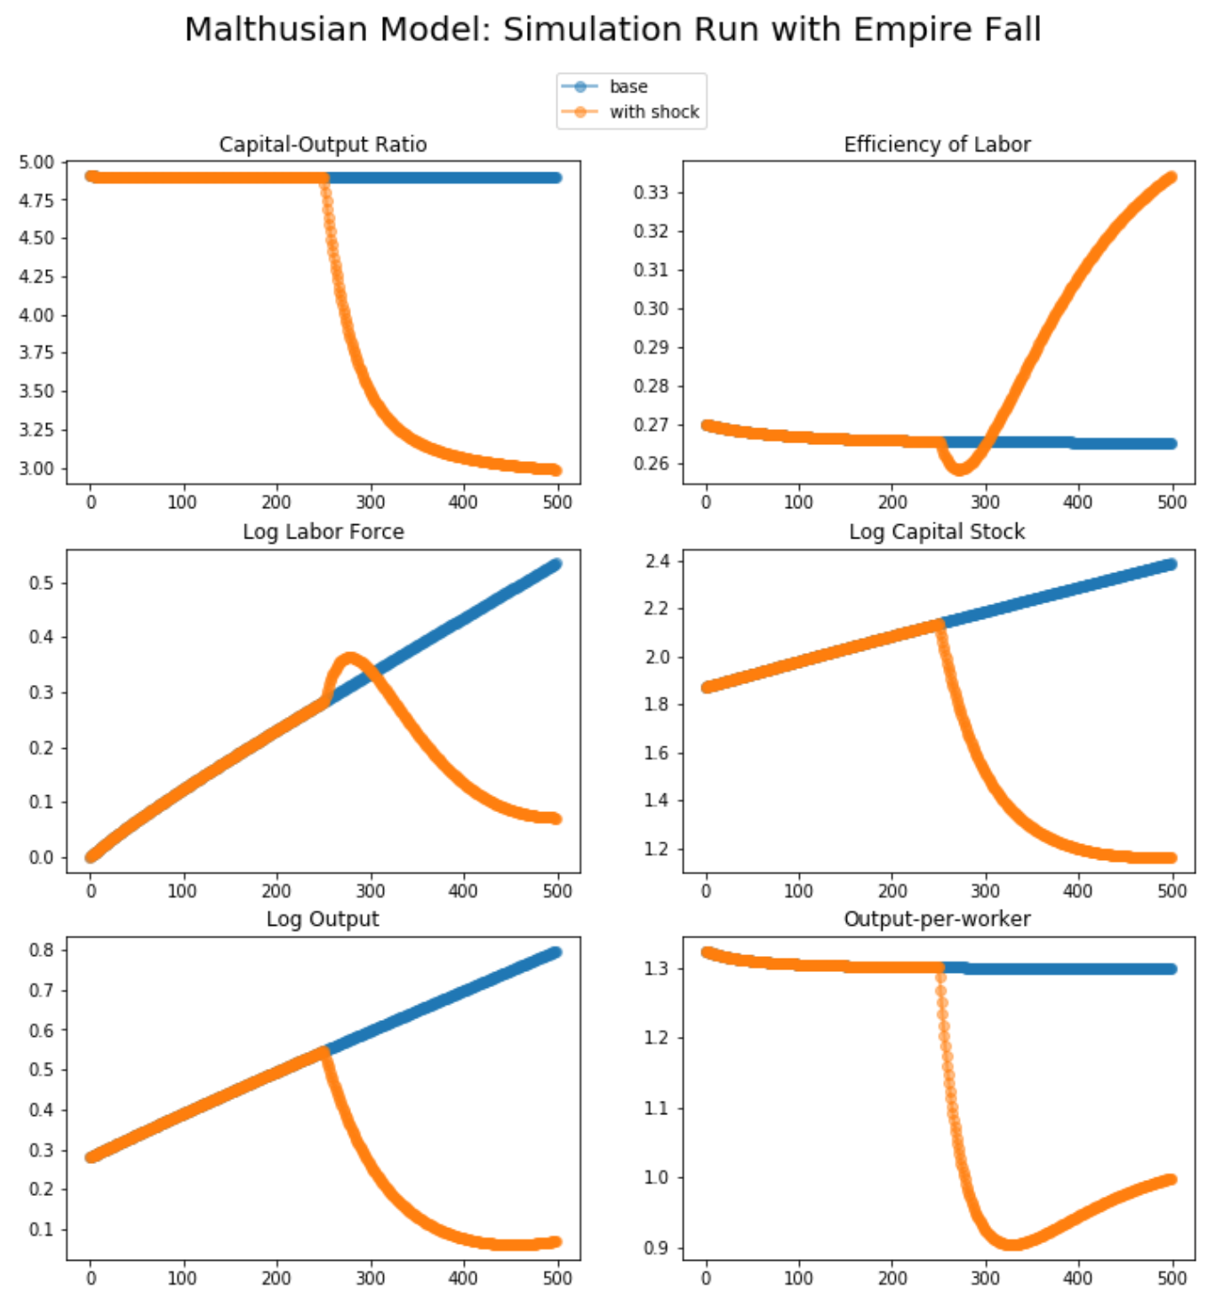
Steady-State and Along the Transition Path
The fall of an empire:
<https://nbviewer.jupyter.org/github/braddelong/LS2019/blob/master/2019-10-14-Ancient_Economies.ipynb>
A decline in inequality, taste for luxuries, and taste for urban living: Δφ = -0.25
A decline in law-and-order that produces a sharp fall in the savings rate: Δs = -0.10

Slide 37
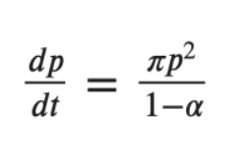
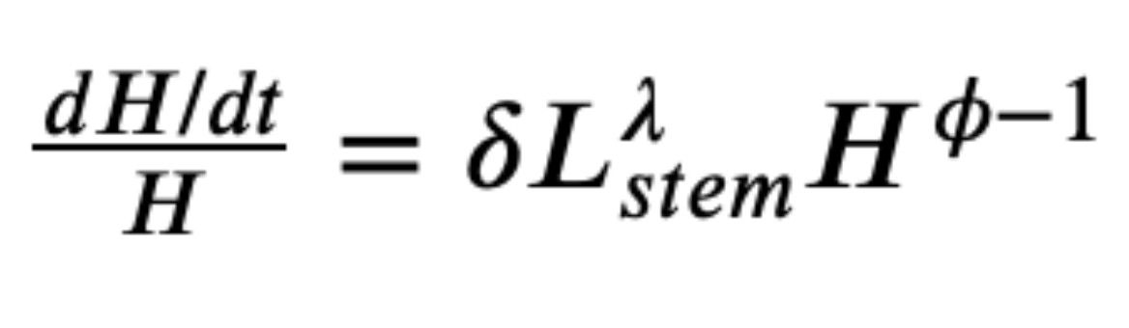
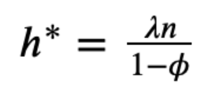
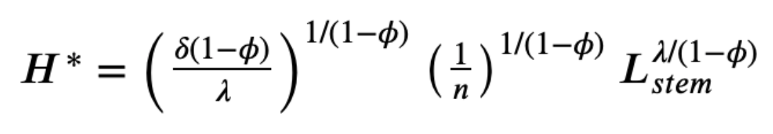
Review: Determinants of Technological and Organizational Progress
How do we make sense of the fact that technological and organizational progress was so slow back then and is so (relatively) rapid now?
Two heads are (almost) better than one
But that does not quite work
Add in additional drag from first picking low-hanging fruit
What causes the increase in Lstem?
What institutions make it profitable for nstem to be higher?
Plus:
Learning by doing
Productivity through embodiment
Technology transfer through contact

Slide 38
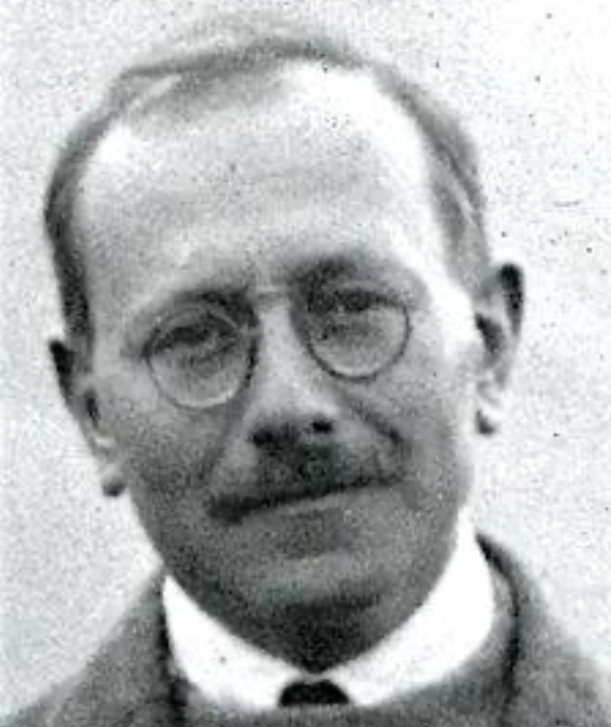
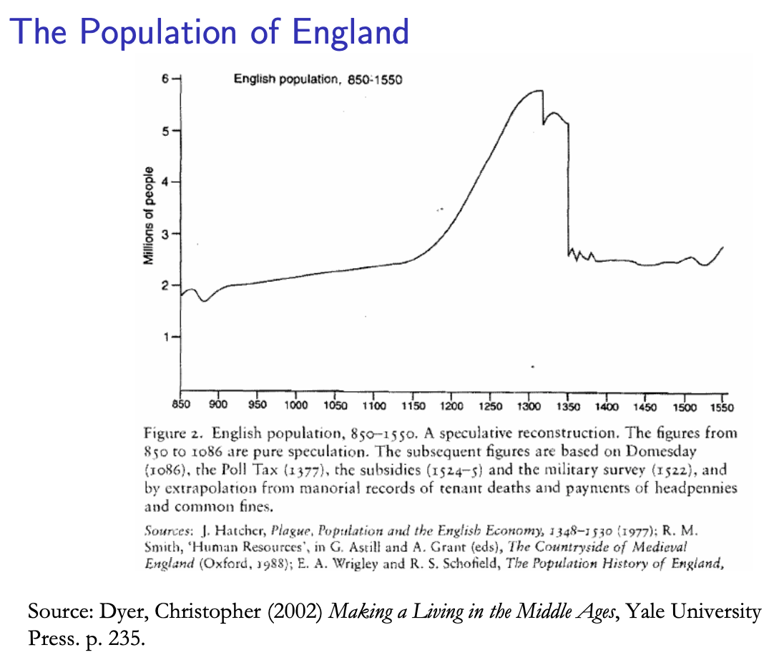
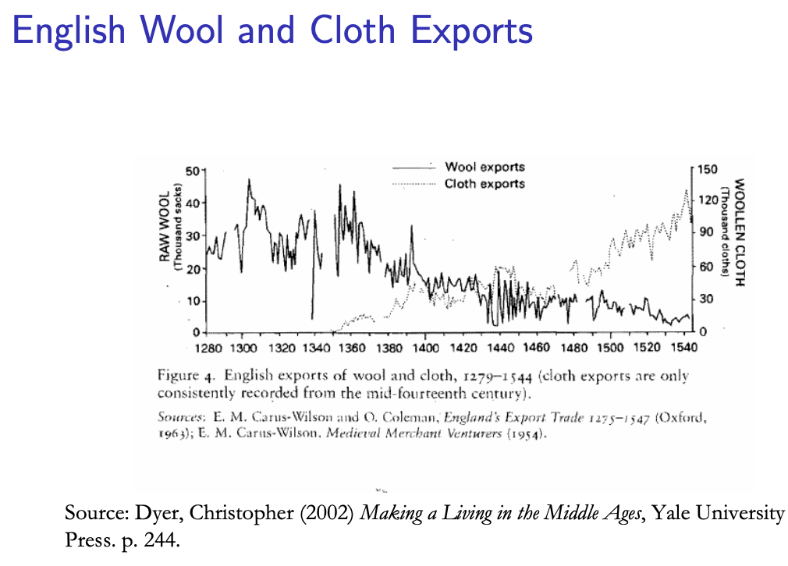
Review: Class and Conflict: at the End of the Middle Ages, Elsewhere, and Elsewhere
What was “feudalism” and how did it end?
Marc Bloch’s definitions:
A subject peasantry
Widespread use of the service tenement (i.e., the fief) instead of a salary (or of private property plus taxation and then purchase)
The supremacy of a caste of specialized warriors
Ties of obedience and protection which bind man to man
Within the warrior class, these ties assume the distinctive form called vassalage
Fragmentation of authority
Disorder and private war
But also, other forms of association, family, and state surviving…
By the late Middle Ages feudalism was a stable system
Trade and population expanded
What data we have shows the number and size of cities increasing
Slide taken from Melissa Dell

Slide 39
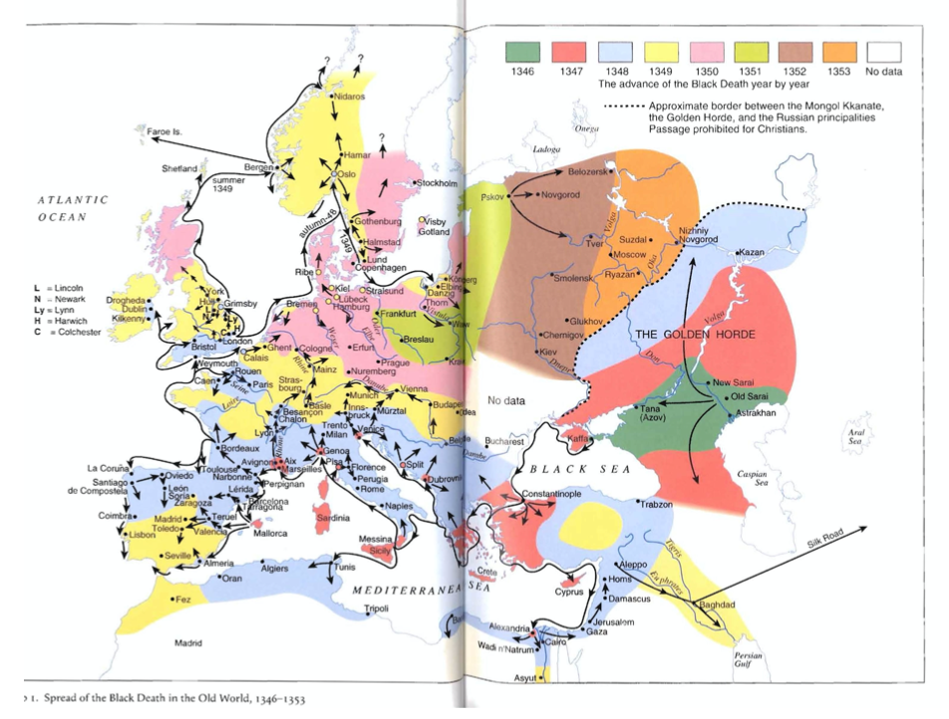
The Black Death and the Collapse of the FMP
The Black Death in Florence: Giovanni Boccaccio:
In the face of its onrush, all the wisdom and ingenuity of man were unavailing .. the plague began, in a terrifying and extraordinary manner, to make its disastrous effects apparent.
It did not take the form it had assumed in the East, where if anyone bled from the nose it was an obvious portent of certain death. On the contrary, its earliest symptom . . . was the appearance of certain swellings in the groin or armpit, some of which were egg-shaped whilst others were roughly the size of a common apple.…
Later on the symptoms of the disease changed, and many people began to find dark blotches and bruises on their arms, thighs and other parts of their bodies ...
Against these maladies .. all the advice of physicians and all the power of medicine were profitless and unavailing .. and in most cases death occurred within three days from the appearance of the symptoms we have described…
Slide taken from Melissa Dell

Slide 40
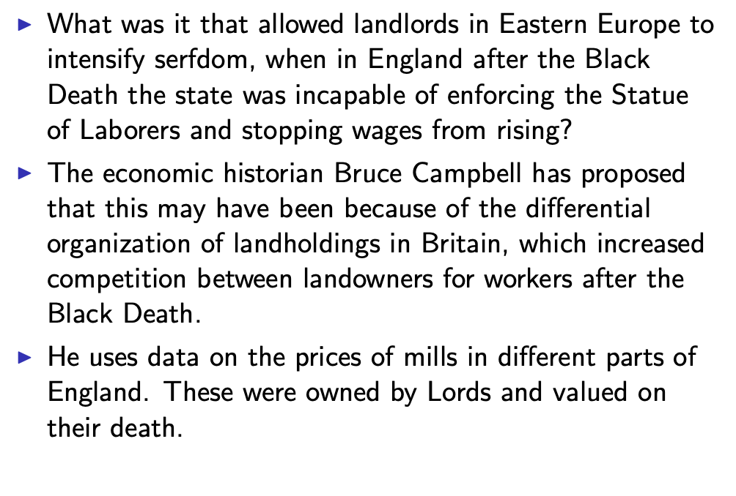
The Emergence from the Middle Ages Begins with the Black Death
Slide taken from Melissa Dell

Slide 41
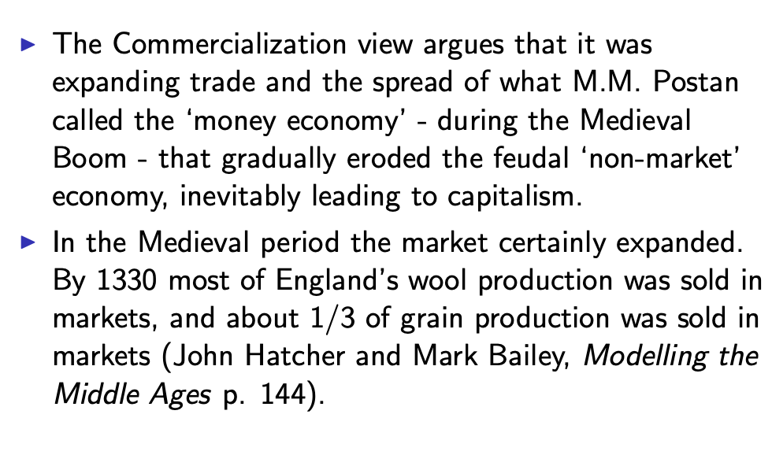
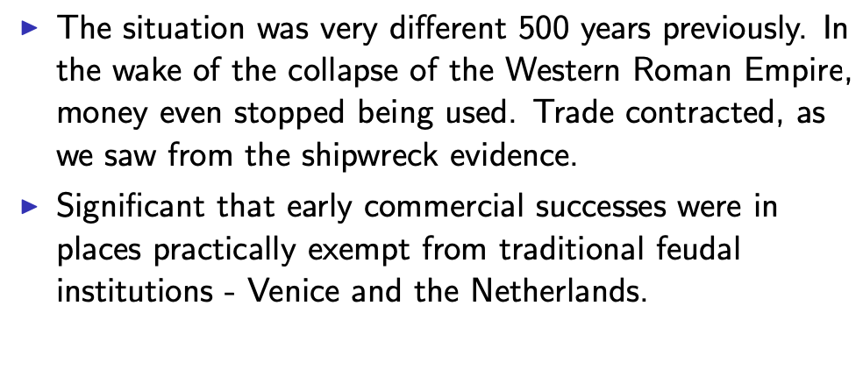
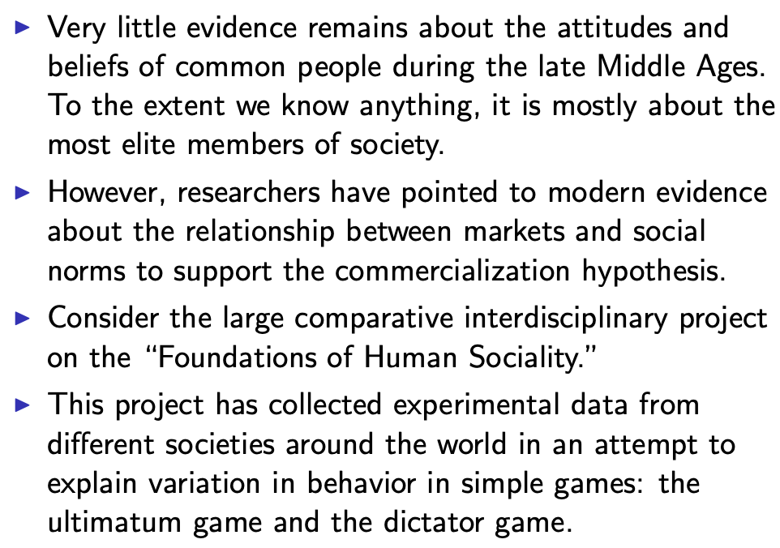
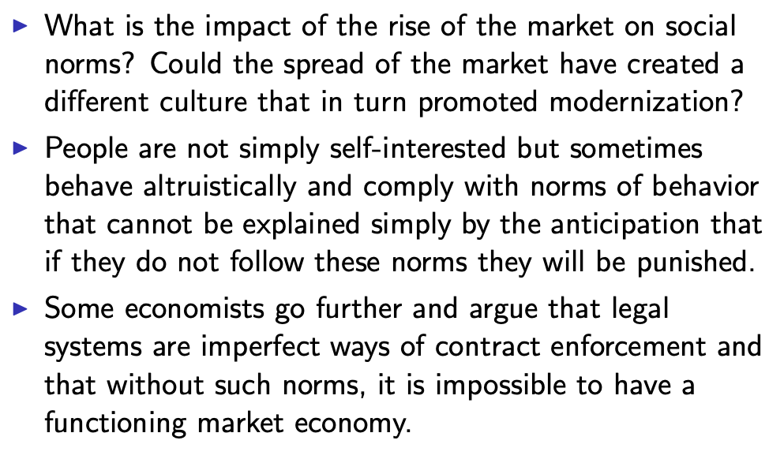
We See “Commercialization” and “Demography” and “Institutions” as Drivers of “Class Power”
Slide taken from Melissa Dell

Slide 42
A Four-Cornered Fight
Kings, Lords, Commons, & Peasants:
Class alliances, class power, and class conflict…
Plus ideological legitimations…
Friedrich Engels: “Exceptional periods, however, occur when the warring classes are so nearly equal in forces that the state power, as apparent mediator, acquires for the moment a certain independence in relation to both. This applies to the absolute monarchy of the seventeenth and eighteenth centuries, which balances the nobility and the bourgeoisie against one another; and to the Bonapartism of the First and particularly of the Second French Empire, which played off the proletariat against the bourgeoisie and the bourgeoisie against the proletariat. The latest achievement in this line, in which ruler and ruled look equally comic, is the new German Empire of the Bismarckian nation; here the capitalists and the workers are balanced against one another and both of them fleeced for the benefit of the decayed Prussian cabbage Junker-squires…”
This is not just in exceptional periods…
The relative autonomy of the state is the rule, not the exception…

Slide 43
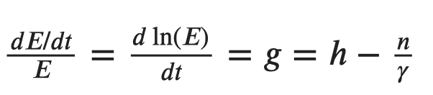
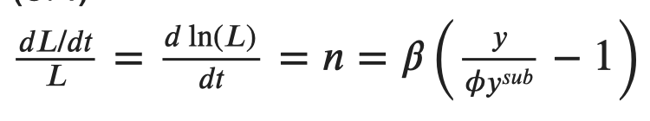

Review: Malthusian Models and Reality

Slide 44

Perhaps Diagrams Are More Intuitive?
Income per-capita always returns to the point where the birth rate is just enough above the death rate to deliver population growth that soaks up technological improvement:
This is the unique attracting steady-state of the model.
What happens if there is a one-time permanent jump up in H that improves technology from A to A′ > A?
This means more output for any level of population.
The initial level of population N∗ now produces an income level y’ > y*.
This leads to higher incomes and an excess of births over deaths since B > D(y′).
In consequence, the population expands from N∗ to N′ until income per-capita is driven back down to where it was before.
􏰀The same is true for other changes which have similar implications for the relationship between population and income, for instance good government.
Slide taken from Melissa Dell

Slide 45
Eastern Europe and the “Second Serfdom”
Eastern Europe after 1348:
The plague seems to have hit most of Europe, and the percentage of people killed was similar across space.
After the plague, landlords in Eastern Europe started to take over large tracts of land and expand their holdings, which were already larger than those in Western Europe.
Towns were weaker and less populous and rather than becoming freer, workers began to see their already existing freedoms encroached on: the Domar hypothesis at work.
This contrasts with the English case, and with Western Europe more generally.
This phenomenon is known as the Second Serfdom, to distinguish it from the original serfdom which had happened in the early Middle Ages.
The effects became especially pronounced after 1500, when Western Europe began to demand the agricultural goods which the East produced such as wheat, rye and livestock.
80 percent of the imports of rye into Amsterdam came east from the Elbe, Vistula and Oder river valleys. Soon half of the Netherlands’ booming trade was with Eastern Europe.
Eastern landlords ratcheted up their control over the labor force to expand their production.
The historical literature emphasizes that the Second Serfdom was distinct and more intense than the original
Lords increased the taxes they levied on their tenants. In Mecklenberg in Eastern Germany in 1500, peasants owed only a few days unpaid labor services a year to landowners. By 1550 this was one day a week and by 1600 three days per week. Workers’ children had to work for the lord for free for several years.
In Hungary, landlords legislated one day a week of unpaid labor services for each worker. In 1550 this was raised to 2 days per week. By the end of the century it was 3 days. Serfs subject to these rules made up 90% of the rural population by this time.
Slide taken from Melissa Dell

Slide 46

Feudal Power and Lordly Competition in England After the Black Death
What kept English lords from being able to keep a lid on wages post-1348?
What was it that allowed the Spanish settlers in Mexico to keep wages so low, when in England after the Black Death the state had been incapable of enforcing the Statue of Laborers and stopping wages from rising?
The economic historian Bruce Campbell has proposed that this may have been because of the differential organization of landholdings in Britain, which increased competition between landowners for workers after the Black Death.
After invading England, William the Conqueror rewarded his army by providing them with feudal landholdings.
In an effort to prevent these nobles from becoming powerful regional warlords who could challenge the king’s power, each noble received landholdings scattered across the country
(The exception was along the Scottish and Welsh borders), where nobles were given large plots for defensive purposes
This division of landholdings meant that in a given region, there were many landholders in close proximity.
This created intense competitive pressures for labor, particularly in the wake of the Black Death
This contrasts to Mexico, where conquistadors were granted vast contiguous tracks of land called encomiendas
Slide taken from Melissa Dell

Slide 47

Is Malthus Right? II
At the macro level, yes; but there are lots of interesting meso- and small-scale puzzles:
In addition, measures of good government, such as proxies for constraints on the executive, are correlated with urbanization in this period.
For example, DeLong and Shleifer (1993) showed there was a strong correlation between form of government and urbanization in the pre-modern world
Charles Wilson (1967): Trade, Society, and the State: "The two areas which in 1500 represented the richest and most advanced concentrations of trade, industry and wealth were the quadrilateral formed by the Italian cities Milan, Venice, Florence and Genoa; and the strip of the Netherlands that ran from Ypres north-east past Ghent and Bruges up to Antwerp. It was not merely coincidence that these were the areas where the tradesmen of the cities had been most successful in emancipating themselves from feudal interference and in keeping at bay the newer threat of more centralized political control offered by the new monarchies. In the fleeting intervals between the storms of politics and war, men here glimpsed the material advance that was possible when tradesmen were left in peace unflattered by the attentions of strategists who regarded their activities as the sinews of war…”
Slide taken from Melissa Dell

Slide 48
Malthus: Summing Up
On the broadest scale only:
The simple Malthusian model may indeed capture some realities.
If labor markets are competitive, population growth may indeed induce a decline in wages.
Or if there is a fixed amount of land and few opportunities for labor intensive cultivation systems, a population increase may lead to a decline in output per worker.
However, the reality is typically much more messy.
How wages respond to changes in income will depend on institutions.
Thus the overwhelming likelihood that institutional or cultural factors also shaped pre-modern growth
It was not simply being dictated by the Malthusian relationship between births, deaths, and income.
Slide taken from Melissa Dell

Slide 49

Review: “Subsistence”

Slide 50



“Bare-Bones”
From Clark & Allen:
"Manual workers”—70% of median, 50% of average income
In 1800: the English population in 1800 is a very rich pre-industrial population
70% of spending spent on food
30-40% grains
20% meat and dairy
“Bare-bones” subsistence
Cities: Malthus rules, but it takes centuries—and other things can and do happen

